Slide 1
A Comparative Study of Sentiment Analysis on Flipkart Dataset using Naïve Bayes Classifier Algorithm
Mohammad Basil Ali Khan
20K-0477
Applied Machine Learning
CS4104
Course Instructor
Sir M. Shahzad

Slide 2
CONTENTS
Overview
Objectives
Key Components and Steps
Key Steps
Dataset Used
Data Preprocessing
Feature Extraction
Algorithm Used
Model Evaluation
Confusion Matrix
Accuracy
Heat map
Conclusion

Slide 3
Overview
Introduction:
The Sentiment Analysis on Flipkart Product Reviews project aims to analyze customer sentiments expressed in reviews of various products available on the Flipkart e-commerce platform. Leveraging Natural Language Processing (NLP) techniques and machine learning algorithms, this project aims to extract insights from customer feedback to understand their sentiments towards different products.
Sentiment Analysis:
Sentiment analysis is the process of analyzing and classifying opinions, emotions, and attitudes expressed in text. With the exponential increase of data available online, it has become essential to employ sentiment analysis to extract meaningful information from this data.

Slide 4
Objective
The primary objective of this project is to develop a sentiment analysis model capable of categorizing customer sentiments expressed in text reviews into positive, negative, or neutral sentiments. By employing various NLP methodologies and machine learning models, the project seeks to provide valuable insights into customer perceptions and preferences regarding different products.

Slide 5
Key Steps
Data Collection and Preprocessing
Exploratory Data Analysis (EDA)
Models Training
Initializing and training Naive Bayes classifiers Bernoulli Naive Bayes Classifier (‘BernoulliNB’), Gaussian Naïve Bayes Classifier (‘GaussianNB’) using the transformed feature matrices and associated labels (e.g., sentiments) from the training dataset.
Model Evaluation
Acquiring a dataset containing product details, prices, ratings, reviews, and sentiments. Data preprocessing involves cleaning, handling missing values, and converting data into suitable formats for analysis.
Visualizing sentiment distribution, word frequency analysis, and feature extraction using CountVectorizer and TfidfVectorizer to comprehend the language patterns and sentiment distribution within the reviews.
Evaluating the trained models using various metrics like accuracy, precision, recall, and confusion matrices to assess their performance on test/validation data.
Analyzing the model's effectiveness in correctly predicting sentiment labels for unseen text data.

Slide 6
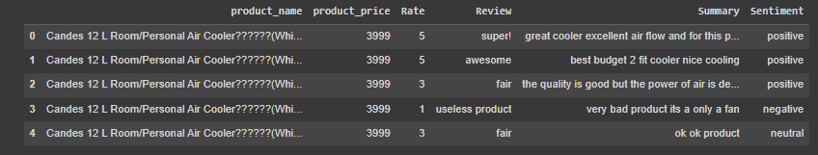
Dataset Used
The dataset contains information related to reviews and sentiments for a specific product. It comprises the following columns:
product_name: Description or name of the product
product_price: Price of the product (e.g., 3999).
Rate: Rating given to the product (e.g., 5 for highly positive, 1 for highly negative).
Review: Textual content containing user reviews or opinions about the product.
Summary: Brief summary or condensed description of the review content.
Sentiment: Categorized sentiment derived from the review (e.g., positive, negative, neutral) based on the expressed opinions.

Slide 7
Data Preprocessing
Data Loading and Inspection loading the dataset using Pandas. Basic data inspection using data.info() and data.head() allows understanding the dataset's structure and the first few entries. | Text Preprocessing Tokenization splits the text into individual words or tokens. Stop word removal eliminates common English stop words that do not carry significant meaning in sentiment analysis. Stemming (PorterStemmer) reduces words to their base or root form to normalize the text data and reduce dimensionality.
Handling Missing Values Identified and addressed missing or null values in the dataset, ensuring data completeness and reliability. using mode imputation (df = df.fillna(df.mode().iloc[0])) to fill missing values with the most frequent entry in those columns. | Feature Extraction: Feature extraction techniques, such as CountVectorizer or TfidfVectorizer, transform the text into numerical representations (e.g., word frequencies, TF-IDF values), enabling machine learning models to process the data effectively.
Filtering Sentiments Filtered the dataset to exclude entries categorized as 'neutral' sentiments (dataset = dataset[dataset.Sentiment.isin(['neutral']) == False]), potentially focusing on instances with clear positive or negative sentiments for analysis purposes. | Custom Tokenization and Feature Extraction Utilized custom tokenization functions (get_stemmed_tokens, stemmed_words) in TfidfVectorizer to perform specialized text preprocessing tasks, enhancing the quality of features extracted from the text data.

Slide 8
Feature Extraction
CountVectorizer:
Functionality: Utilized CountVectorizer from Scikit-learn to convert text data into a matrix of token counts.
Process: Tokenized the text into individual words (or tokens) and created a matrix representing word frequencies across documents.
Purpose: Enables the creation of a numerical feature matrix based on the occurrence of words in the text corpus.
TfidfVectorizer:
Functionality: Employed TfidfVectorizer to convert text data into a TF-IDF (Term Frequency-Inverse Document Frequency) representation.
Process: Transformed text documents into numerical feature vectors using TF-IDF values, considering word frequencies and importance across documents.
Advantages: Weighs the importance of words by their occurrence frequency while considering their rarity in the entire corpus.

Slide 9
Algorithm Used
Bernoulli Naive Bayes (BernoulliNB)
Functionality:
Implemented BernoulliNB classifier from Scikit-learn for sentiment classification.
Features:
Suited for binary features (presence or absence of words), typically used for text classification tasks.
Training:
Trained the Bernoulli Naive Bayes model using the feature matrices obtained from TF-IDF or CountVectorizer.
Gaussian Naive Bayes (GaussianNB)
Functionality:
Another Naive Bayes classifier (GaussianNB) considered for sentiment classification.
Features:
Assumes features follow a Gaussian distribution, works well with continuous features.
Training:
Explored as an alternative model for sentiment analysis, possibly for comparison with Bernoulli Naive Bayes..

Slide 10
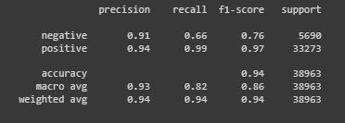
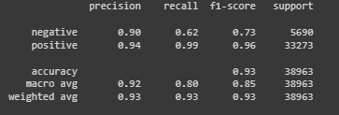
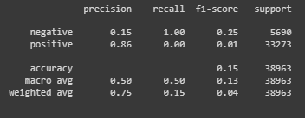
Model Evaluation: Classification Report
BernouliNB using CountVectorizer
BernouliNB using TFIDF (ngrams(1,2)
GaussianNB using TFIDF

Slide 11


Accuracy
BernouliNB using CountVectorizer
GaussianNB using TFIDF
BernouliNB using TFIDF (ngrams(1,2)

Slide 12
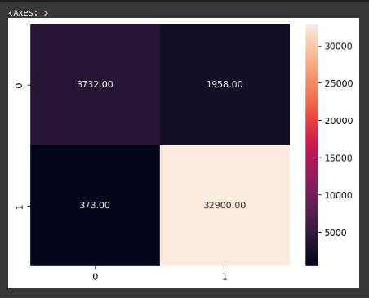
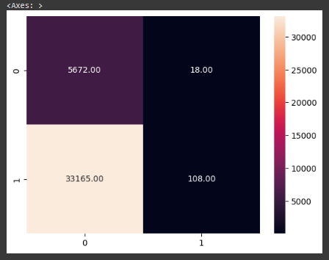
Confusion Matrix
BernouliNB using CountVectorizer
GaussianNB using TFIDF

Slide 13
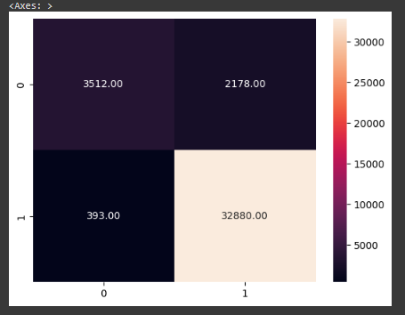
Confusion Matrix Contd.
BernouliNB using TFIDF (ngrams(1,2)

Slide 14
Conclusion
The project focused on sentiment analysis using a dataset comprising product Through the implementation of various natural language processing (NLP) techniques and machine learning models, several key findings and outcomes were observed:
The initial steps involved data loading, exploration, and preprocessing. This included handling missing values, visualizing the distribution of sentiments, and filtering out neutral sentiments to create a more balanced dataset.
Multiple methods were employed for feature extraction, such as CountVectorizer and TF-IDFVectorizer. These techniques transformed text data into numerical representations suitable for machine learning models. Additionally, the use of stemming and n-gram generation helped in capturing essential linguistic patterns.
Various classifiers were employed, including Bernoulli Naive Bayes and Gaussian Naive Bayes. These models were trained on the extracted features and evaluated based on classification reports, confusion matrices, and accuracy scores.
Both count-based (CountVectorizer) and frequency-based (TF-IDFVectorizer) methods were utilized for feature extraction. The TF-IDF method considered the importance of words based on their frequency in the document and across the dataset, showcasing the importance of unique terms.

